Slide 1
Smart Street Lights
Project Team
Prashant Rupapara (Mtech RA Electrical)
Shreyas Shyamsunder(Mtech RA Electrical)
Bhaskar Bandyopadhyay(Mtech TA CSRE)
Shailesh Jain(CSE- Project Staff)

Slide 2
Why Need for Smart Street Lights
No intelligence in present architecture
No Monitoring and Diagnostics
No Control over the intensity
Power saving is very less. Energy inefficient.
Maintenance is not easy

Slide 3
System Architecture
Server(PC)
Hub(RPi- with internet)
Nodes(uC with Xbee)
Nodes
Nodes…
Hub
Nodes
Nodes…

Slide 4
Features of our system
On/Off Control based on Sunlight.
Intensity Control based on the environmental conditions.
Smart Node for communicating status
Monitoring and remote diagnostics of the Faulty Street Lights
Cost Effective system
Easy installation
Scalable
Power measurement
Can be used as strobe for traversal, traffic data collection etc

Slide 5
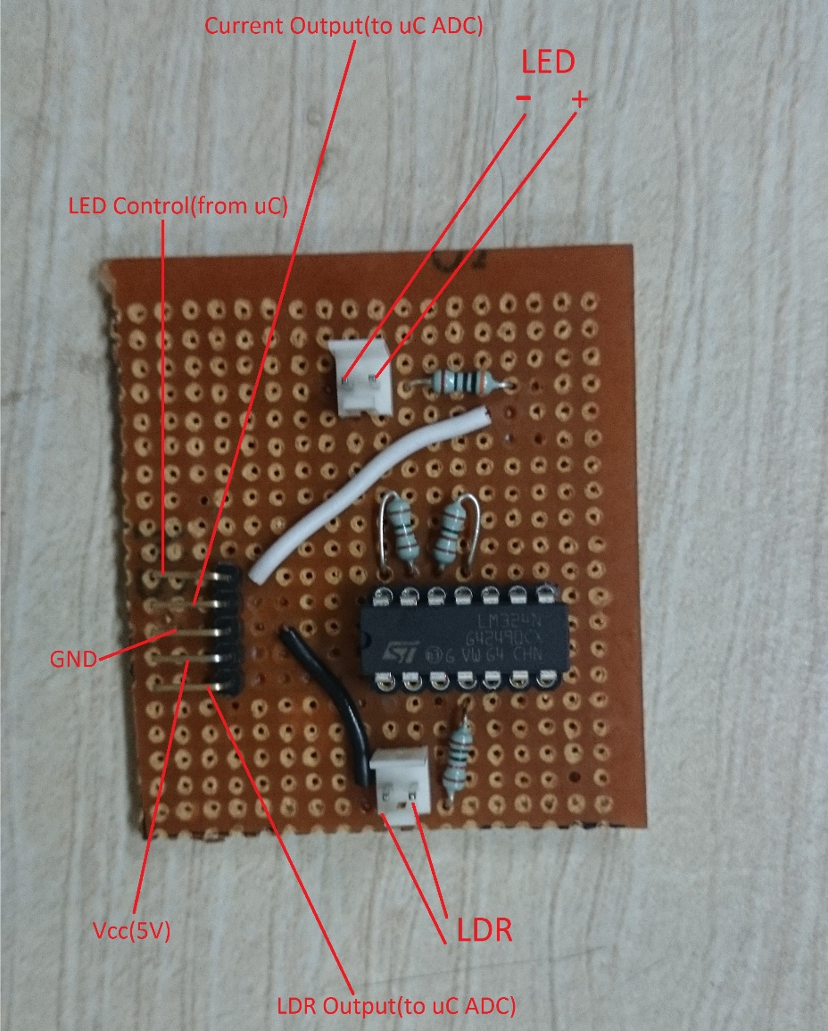
DC Current Sensor

Slide 6
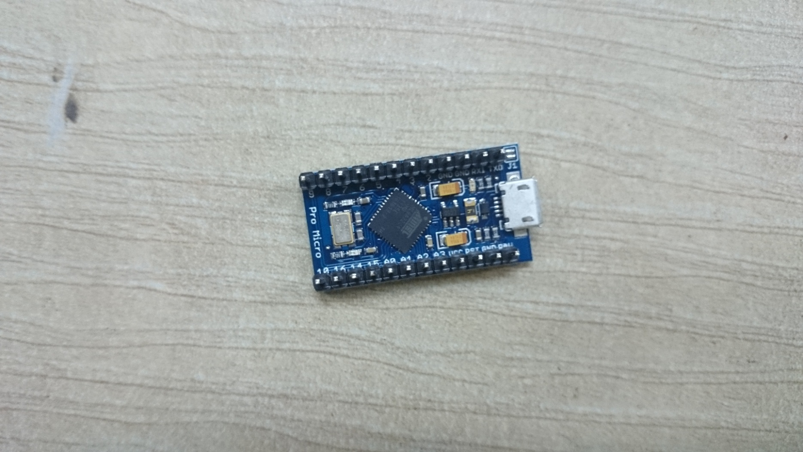
Arduino Pro along with Xbee

Slide 7
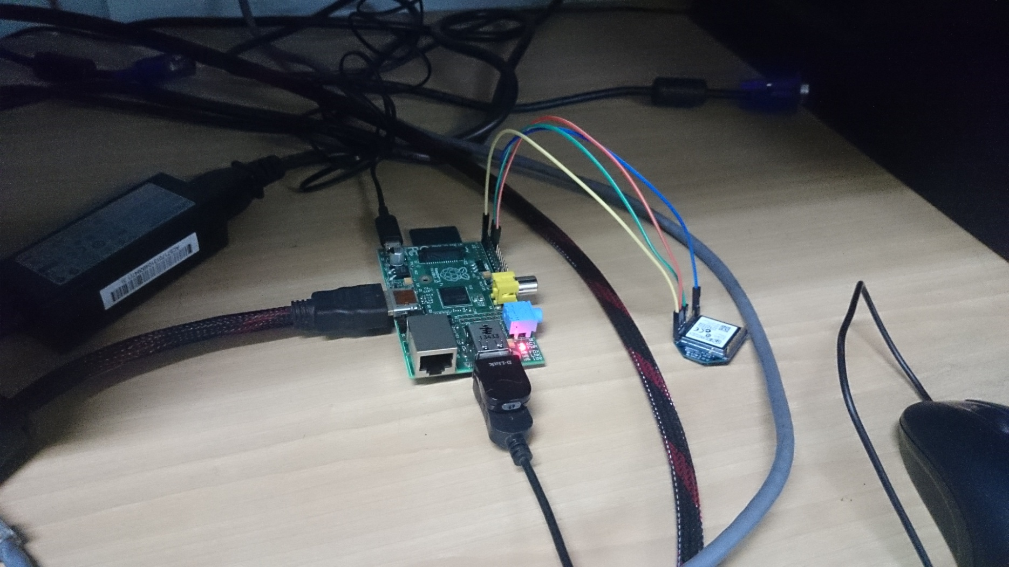
Hub- Raspberry Pi

Slide 8

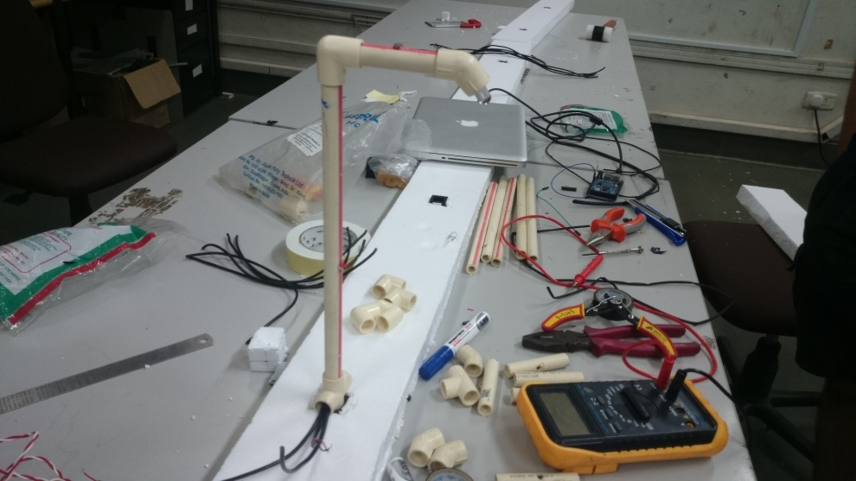
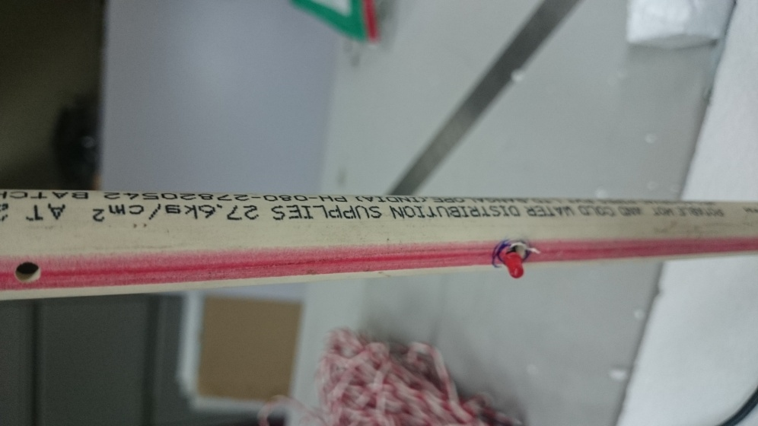
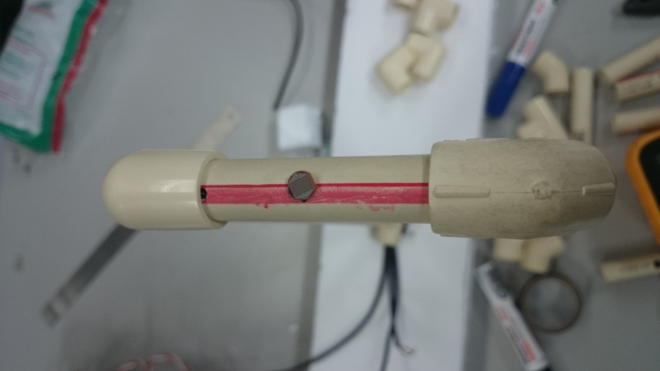
Street Light Structure

Slide 9
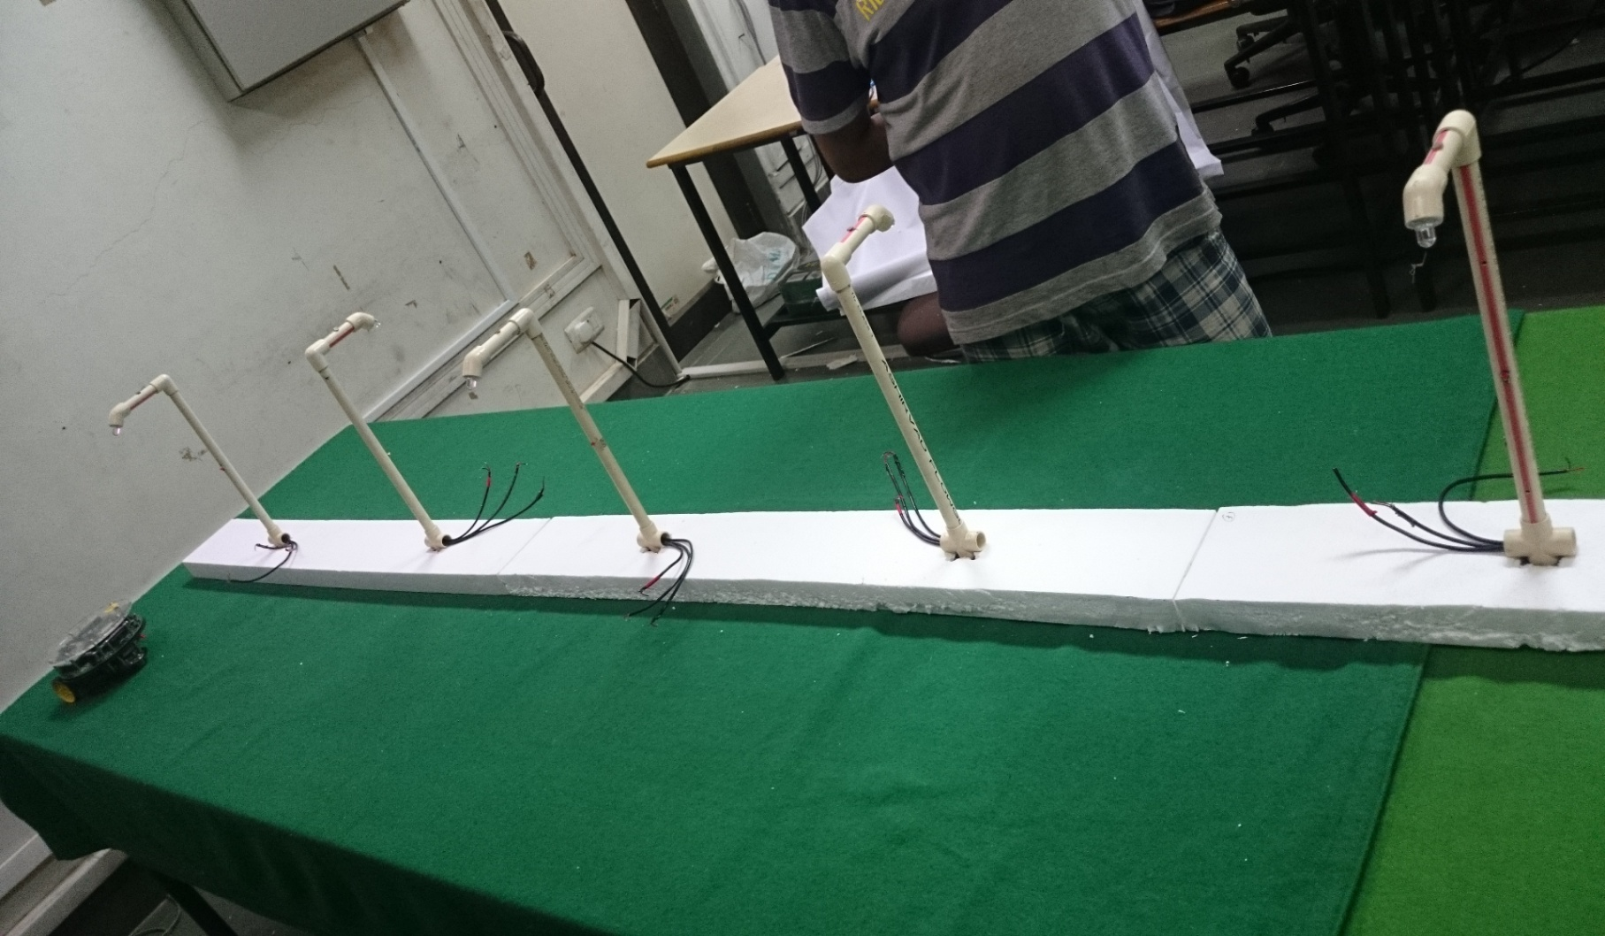
Street Light Arrangements

Slide 10
Thank You

